Slide 1



Precast/prestressed concrete institute
Big Beam Contest
CENE 486C: Capstone Presentation
April 20, 2017
Qusai Al Ghalbi, Mohammed Alradhi, Kacy Aoki, Rick Wilson

Slide 2

Stakeholders
NAU Department of Civil Engineering, Construction Management and Environmental Engineering (CECMEE)
Precast/Prestressed Concrete Institute (PCI)
TPAC Kiewit Western
Dr. Robin Tuchscherer
Figure 1: Dr. Robin Tuchscherer [1]

Slide 3


Introduction
Yearly competition held by PCI
Contest ends June 17, 2017
Purpose
Design a prestressed concrete beam according to the PCI Big Beam competition rules
Figure 2: TPAC Logo [2]
Figure 3: PCI Logo [3]

Slide 4
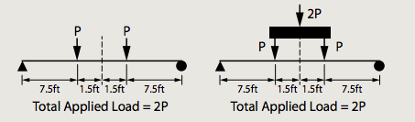
Project Description
Length of prestressed beam:
  Simply supported beam of 18 feet center to center of bearing
  No longer than 20 feet overall
Load Requirements for maximum points:
  Cannot crack under the service load of 20 kips
  Must fail between 32 kips and 39 kips
Figure 4: Allowable load configurations [4]

Slide 5
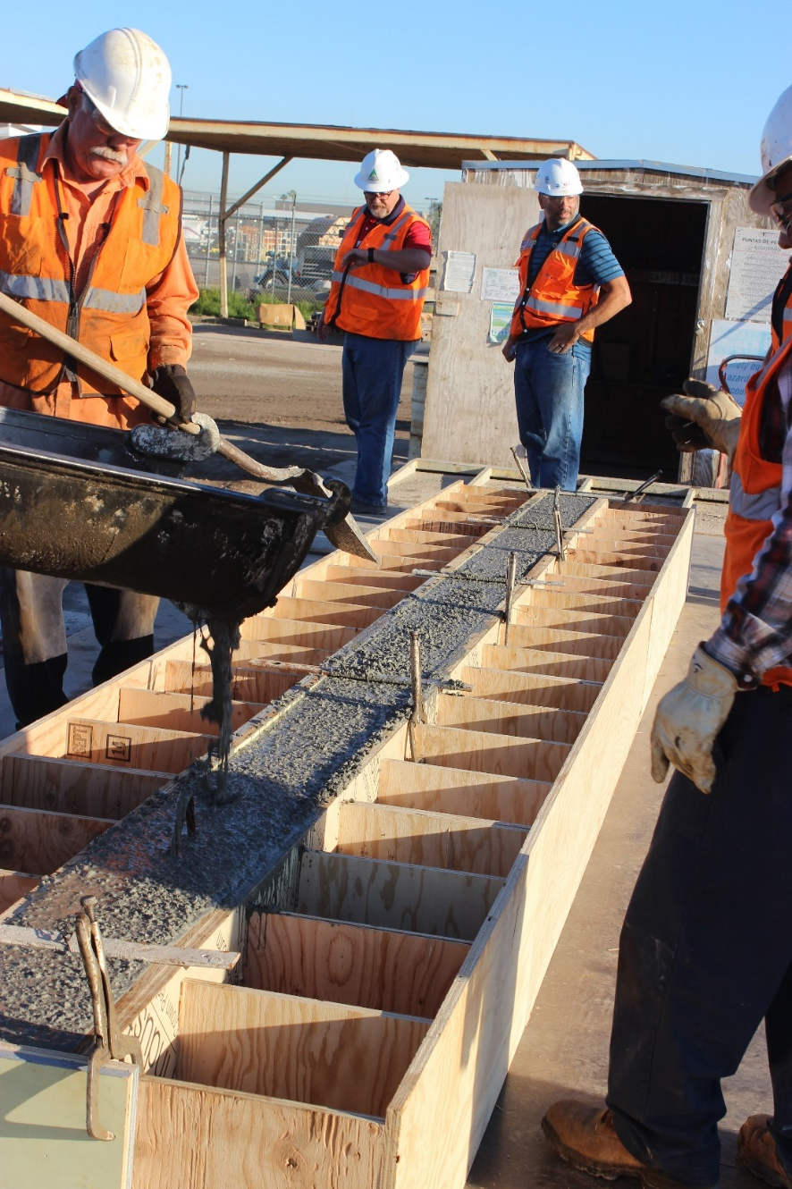
Judging Criteria
Design accuracy
Lowest cost
Lowest weight
Largest measured deflection
Accuracy of predictions
Report quality
Use of code
Figure 5: Pouring of Beam [5]

Slide 6
Concrete Mix Design
TPAC’s Lightweight (LW) and Normal weight (SCC) mix + 4 new mixes
Table 1: Mix Design Materials
Mix | Cement Type | Pozzolan | Aggregate
TPAC – LW | Type II | Fly Ash | Sand, Shale
Mix #1 | Type III | 50% FA*/50% SF* | Sand, Shale
Mix #2 | Type III | Fly Ash | Sand, Cinders
TPAC – SCC | Type II | Fly Ash | Sand, River Rocks
Mix #3 | Type III | Fly Ash | Sand, Quartz
Mix #4 | Type III | 50% FA/50% SF | Sand, River Rocks
*FA = Fly Ash/SF = Silica Fume

Slide 7
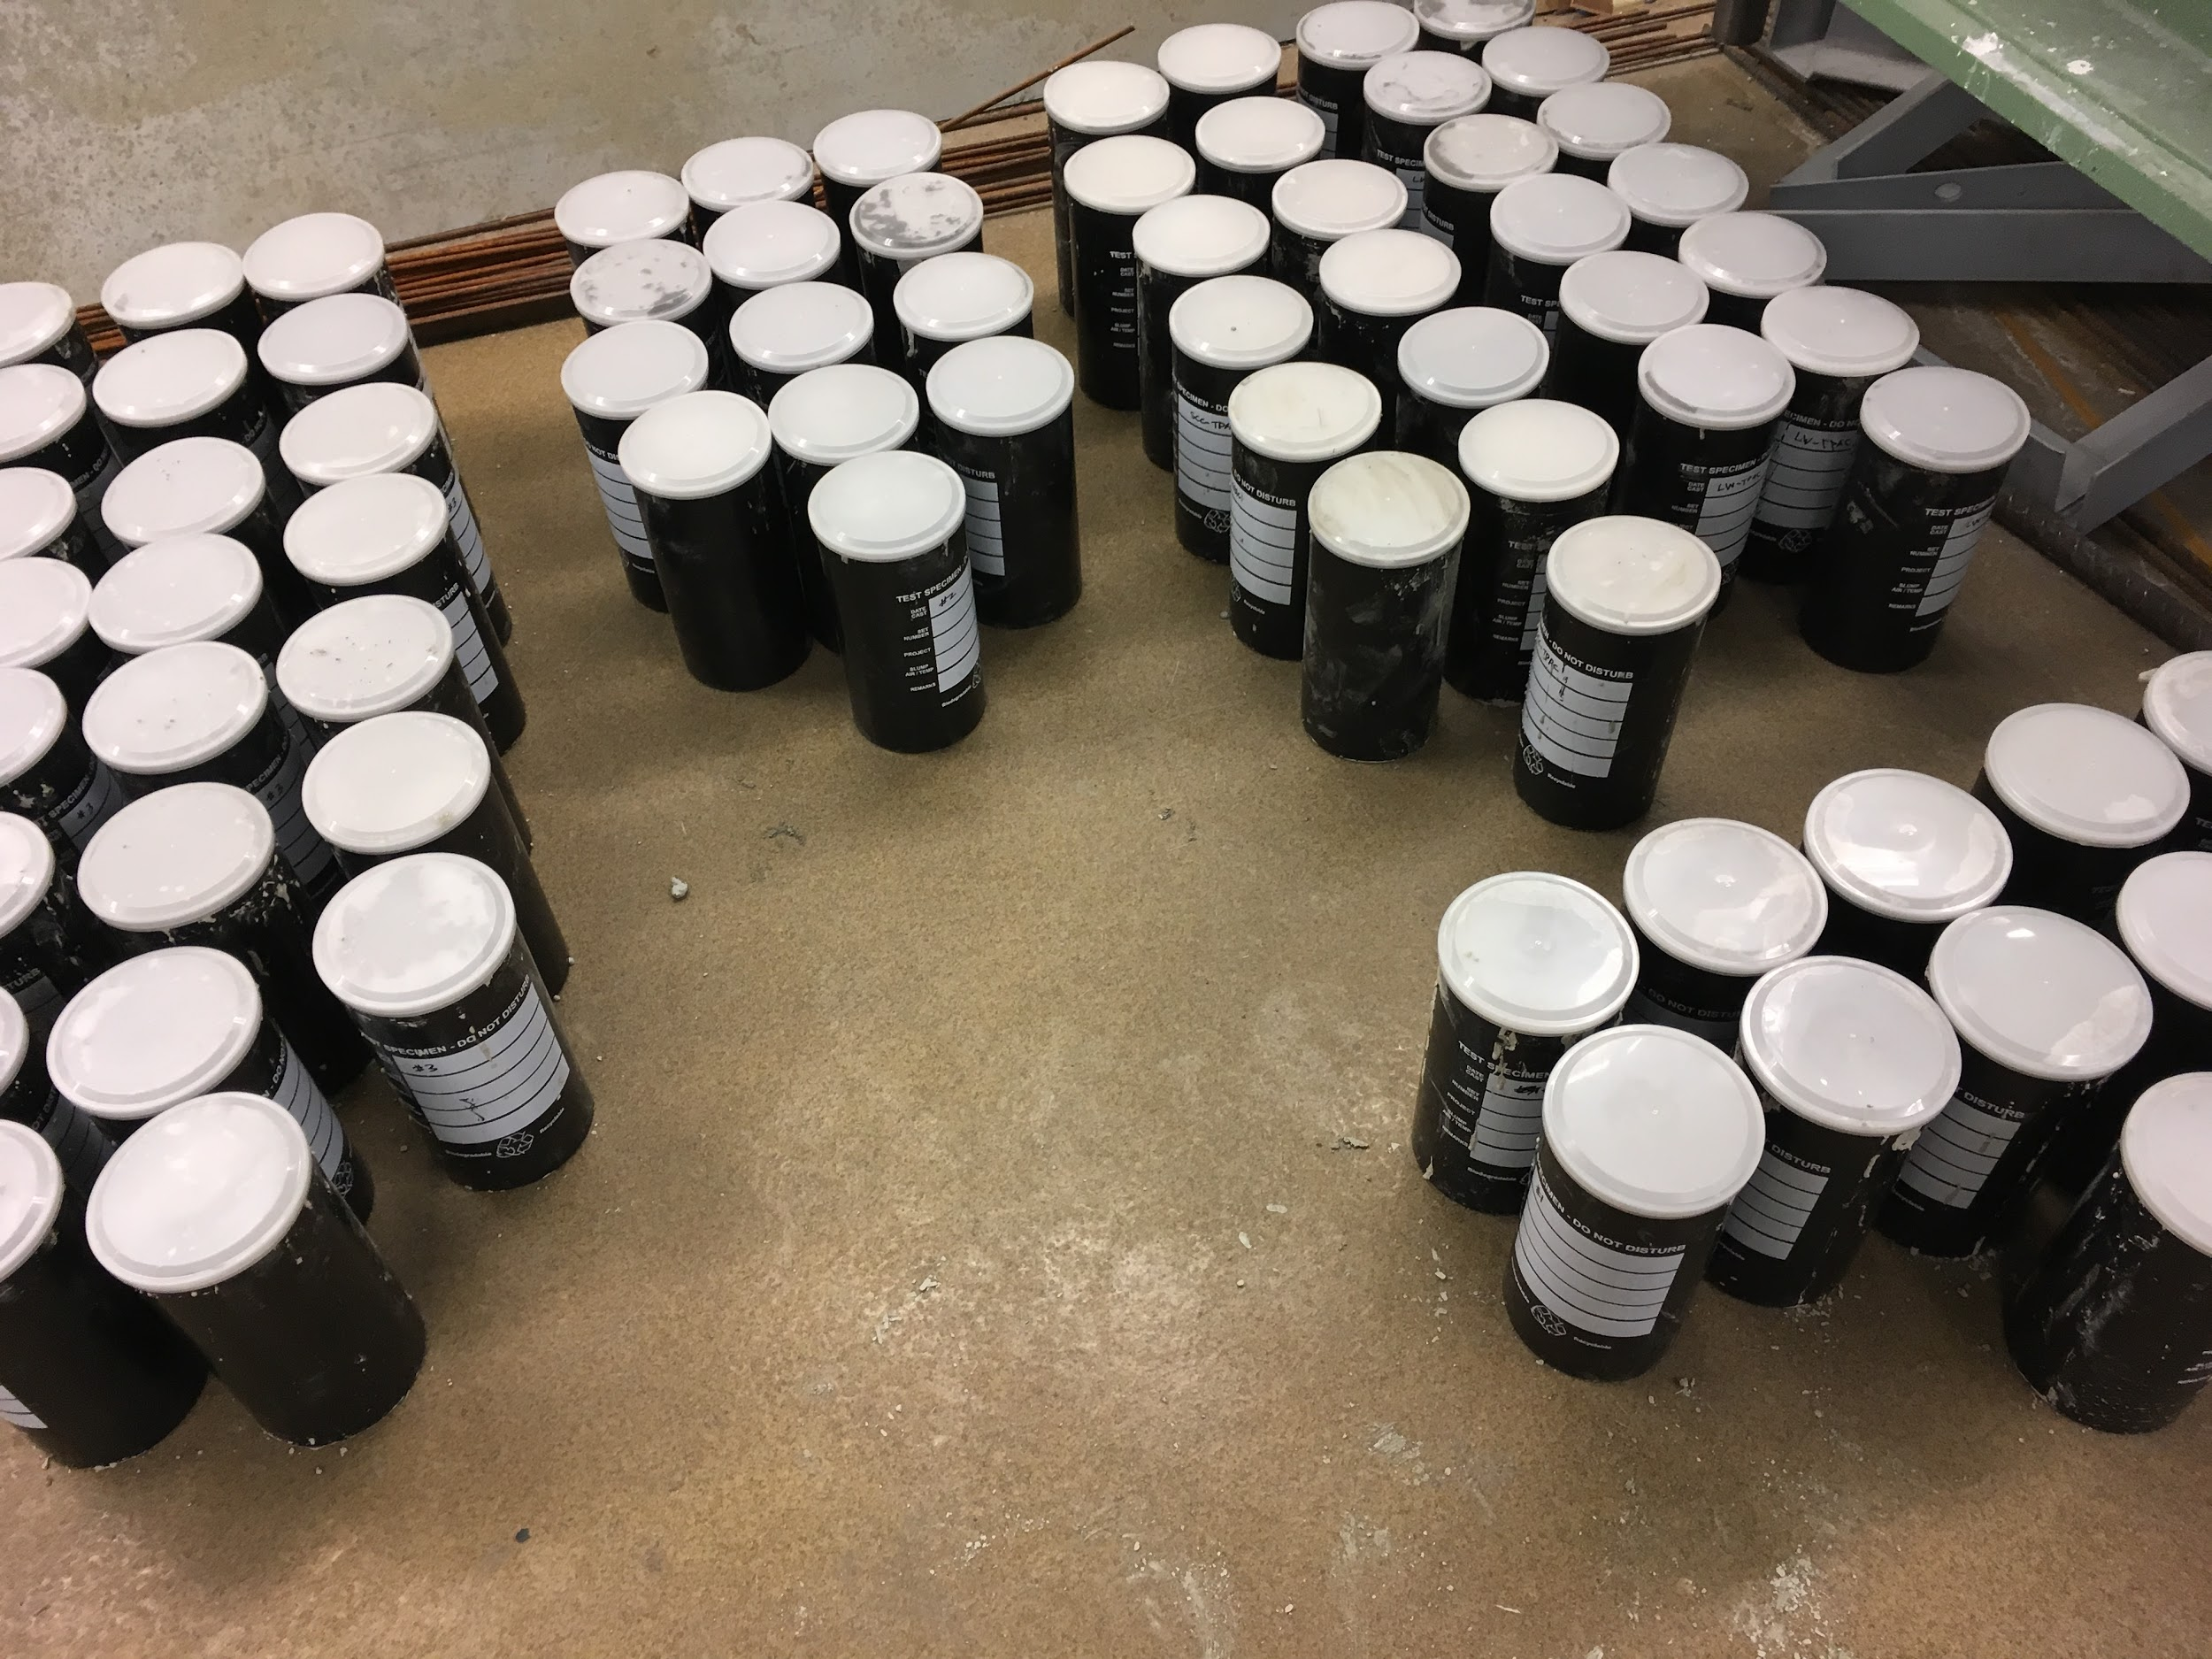
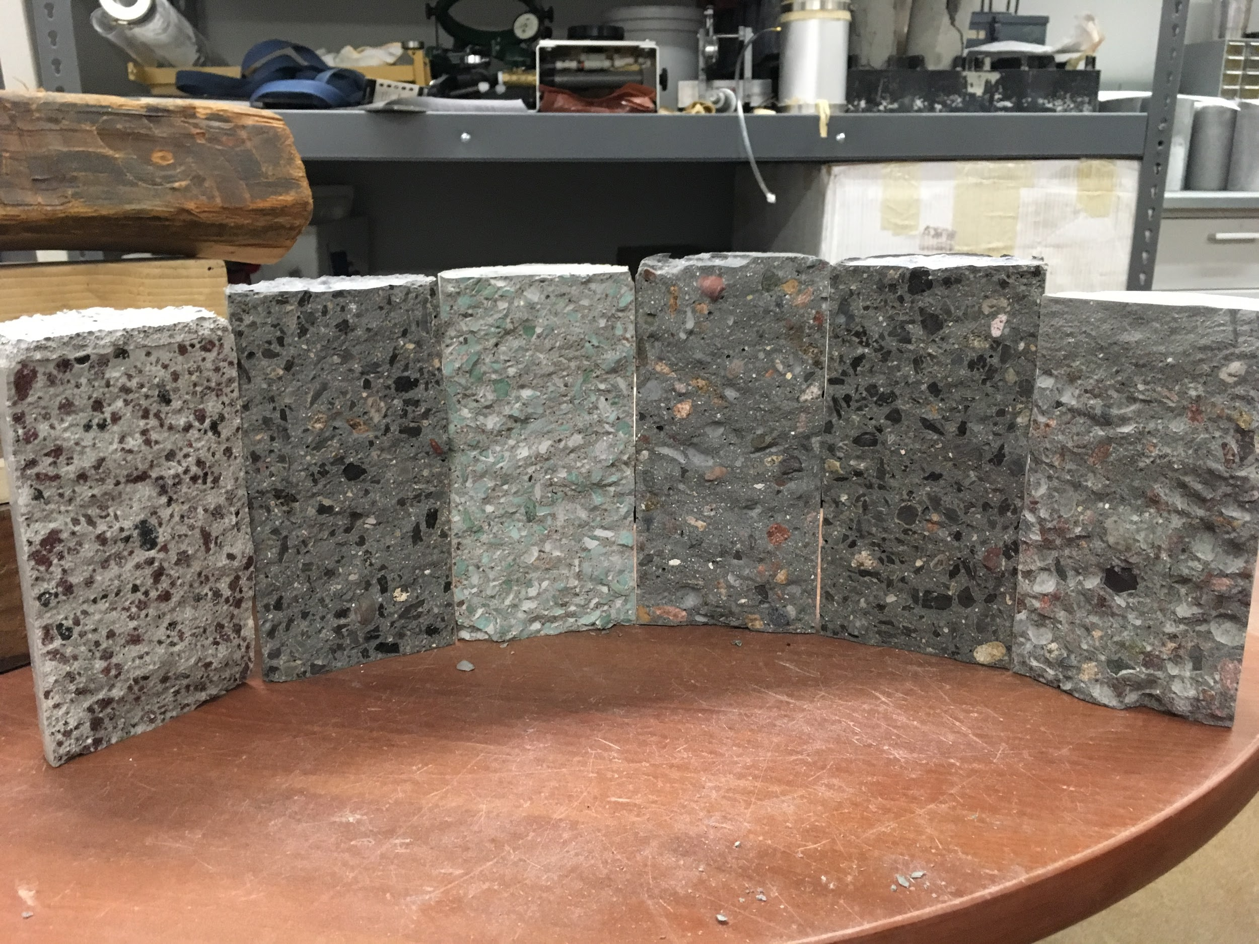
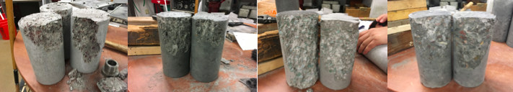
Mix Analysis
Compression Test
  ASTM C39
Split Cylinder Test
  ASTM C496
Stress-Strain Test
  ASTM C469
#2
#3
#4
LW
#1
SCC
Figure 6: Cylinders [6]
Figure 7: Split Cylinder Tests on Six Mixes [6]
Mix #1
Mix #2
Mix #3
Mix #4
Figure 8: Compression Tests[6]

Slide 8
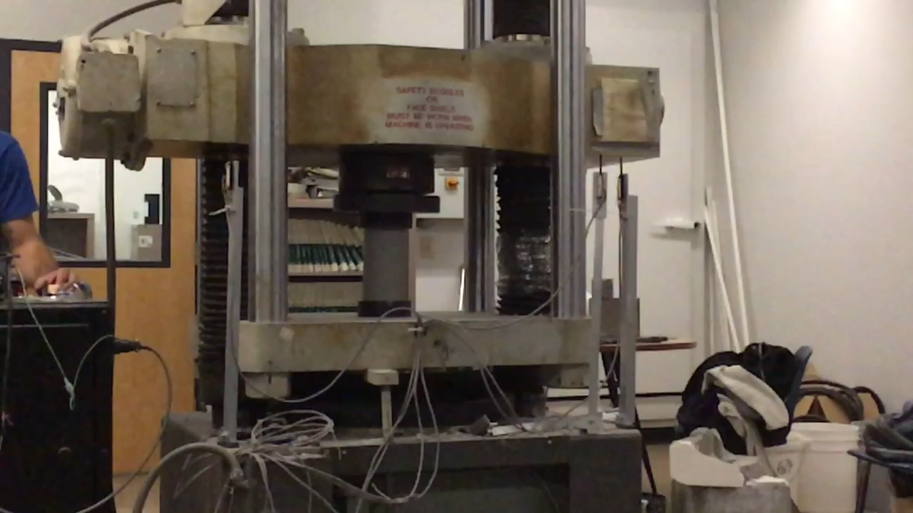
Compression Testing

Slide 9
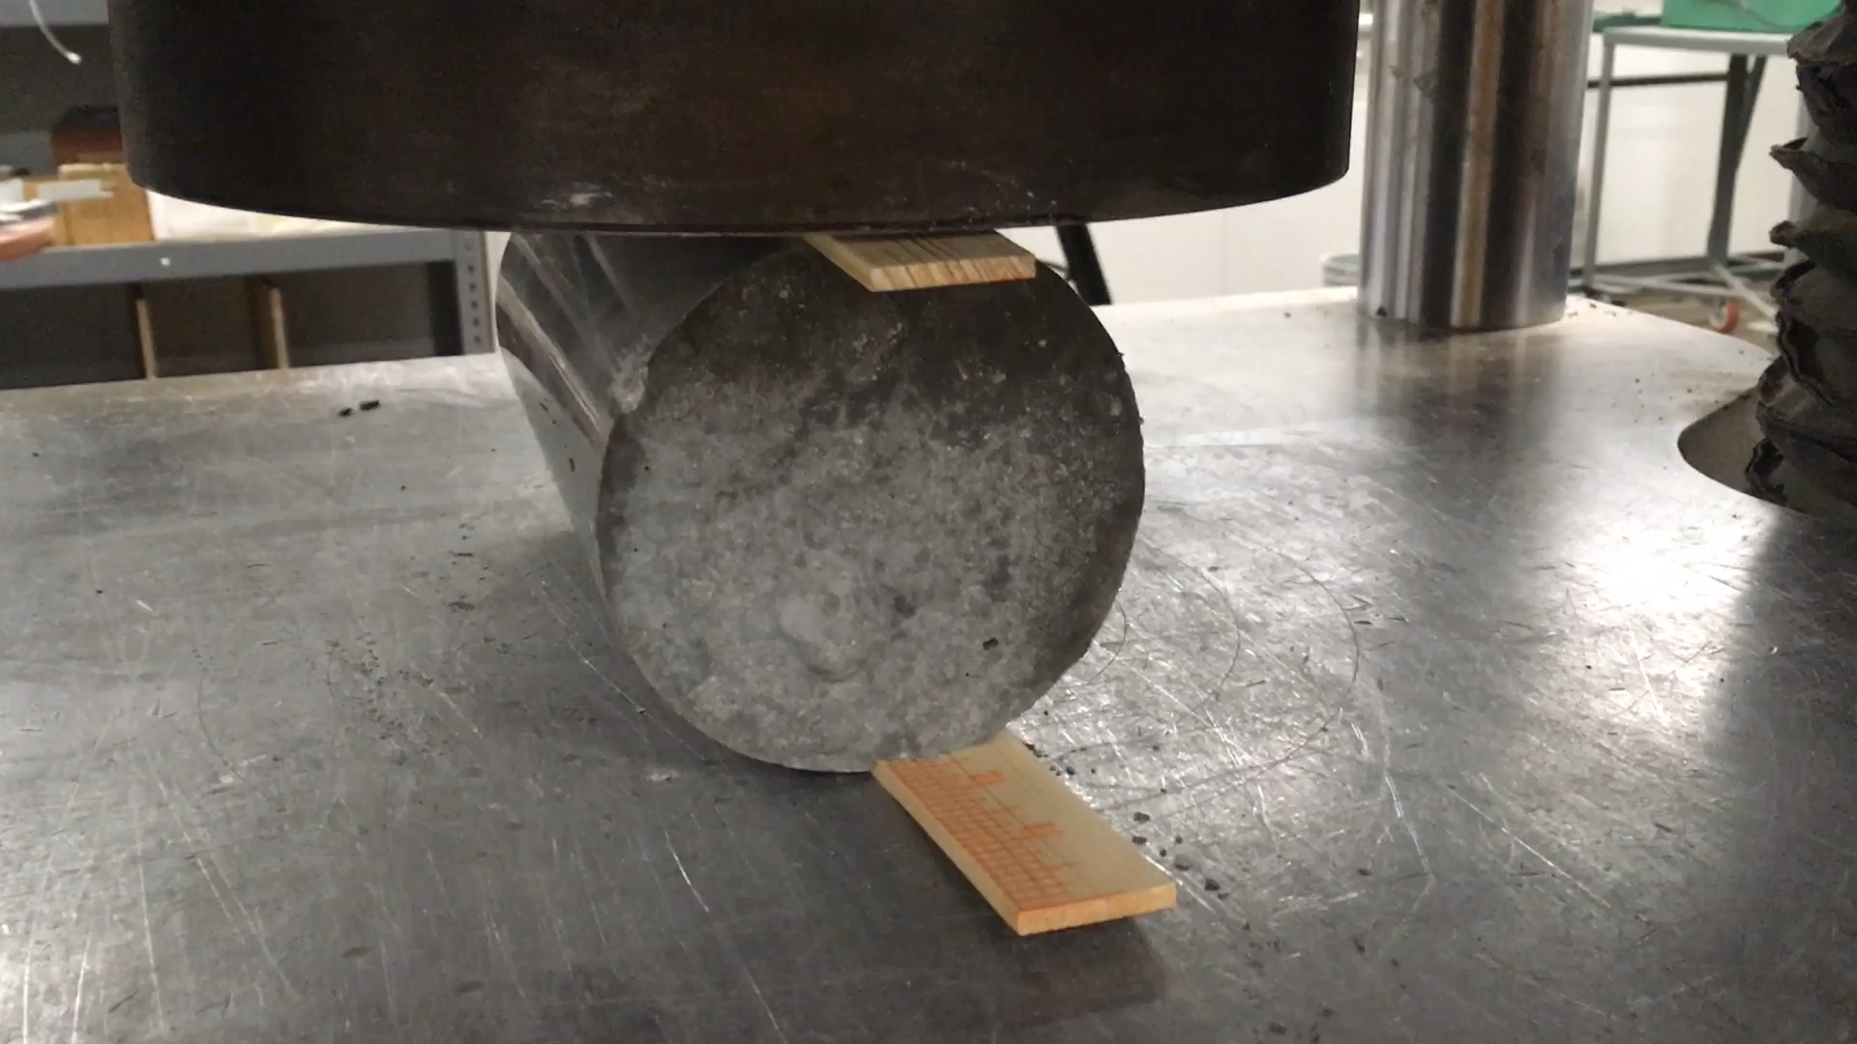
Split Cylinder Testing

Slide 10
Test Results
Table 2: Tests Results
 | Compression (PSI) | Modulus of Elasticity (PSI) | Peak Strain (in/in) | Tension (PSI)
Mix #1 | 5257 | 9.73E+06 | 0.00122 | 327
Mix #2 | 8407 | 5.07E+06 | 0.00235 | 482
Mix #3 | 8566 | 4.66E+06 | 0.00220 | 498
Mix #4 | 8905 | 4.86E+06 | 0.00202 | 560
LW | 7609 | 3.46E+06 | 0.00265 | 497
SCC | 8365 | 4.63E+06 | 0.00186 | 511

Slide 11
Mix Scoring
Table 3: Normalized Mix Scoring
Mix | Compression | Modulus of Elasticity | Peak Strain | Tension | Score
Mix #1 | 0.59 | 0.36 | 0.46 | 0.58 | 1.99
Mix #2 | 0.87 | 0.68 | 0.89 | 0.86 | 3.30
Mix #3 | 0.96 | 0.74 | 0.83 | 0.89 | 3.42
Mix #4 | 1.00 | 0.71 | 0.76 | 1.00 | 3.48
LW – TPAC | 0.85 | 1.00 | 1.00 | 0.89 | 3.74
SCC – TPAC | 0.93 | 0.75 | 0.70 | 0.91 | 3.29

Slide 12
Final Mix Design: TPAC’s LW Mix
Table 4: Mix Details
Material | Weight
Type II Arizona Portland Cement | 730 lbs
Class F Fly Ash | 185 lbs
WCS Maricopa | 1328 lbs
½” Expanded Shale | 867 lbs
Water | 308 lbs
Estimated Air | 1.00%
Admixtures
Advacast 575: High-Range Water-Reducing | 73 oz
VmarF-100: Concrete Rheology-Modifying | 24 oz
Recover: Hydration Stabilizer | 20 oz
Vmar3: Rheology-Modifying | 10 oz

Slide 13
Beam Design
Changes in Designs
Dimension
Steel amount
Shape
Steps for Analysis:
Find stress at release
Determine cracking load
Calculate ultimate capacity
Check shear
Predict deflections
Stress at Release
Cracking Load
Shear Envelope
Ultimate Capacity
Figure 9: MathCAD [1]

Slide 14
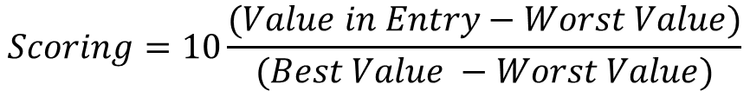
Beam Scoring
Table 5: Beam Scoring
Design | Cost | Weight | d (in) | Score- Cost | Score- Weight | Score - d | Score
1 | $131.71 | 1174 | 13.5 | 10.0 | 8.5 | 8.9 | 27.4
2 | $136.88 | 1454 | 13 | 9.0 | 7.0 | 9.6 | 25.6
3 | $158.80 | 2111 | 12.75 | 4.7 | 3.3 | 10.0 | 18.0
4 | $157.36 | 1374 | 19.5 | 5.0 | 7.4 | 0.0 | 12.4
5 | $149.55 | 967 | 13.5 | 6.5 | 9.6 | 8.9 | 25.0
6 | $158.69 | 903 | 13.5 | 4.7 | 10.0 | 8.9 | 23.6
7 | $160.81 | 967 | 13.5 | 4.3 | 9.6 | 8.9 | 22.8
8 | $155.80 | 1959 | 13 | 5.3 | 4.2 | 9.6 | 19.1
9 | $183.06 | 2713 | 13 | 0.0 | 0.0 | 9.6 | 9.6
10 | $150.39 | 992 | 13.5 | 6.4 | 9.5 | 8.9 | 24.8
$$Scoring=10\frac{(Value in Entry−Worst Value)}{(Best Value −Worst Value)}$$

Slide 15
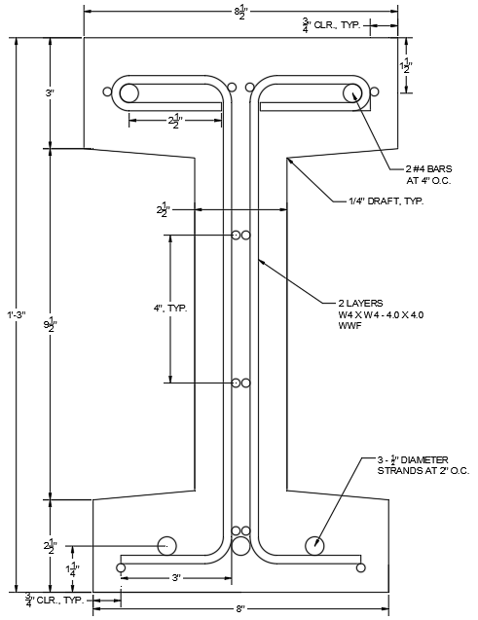
Final
Design
Total Weight: 1217.7 lbs
  Volume = 9.62 ft³
  Unit Weight = 126.6 lb/ft³
Total Cost: $179.40
  Concrete
  Prestressing Strands
  Rebar #4
  Mesh
  Formwork
Figure 10: Final Design [6]

Slide 16
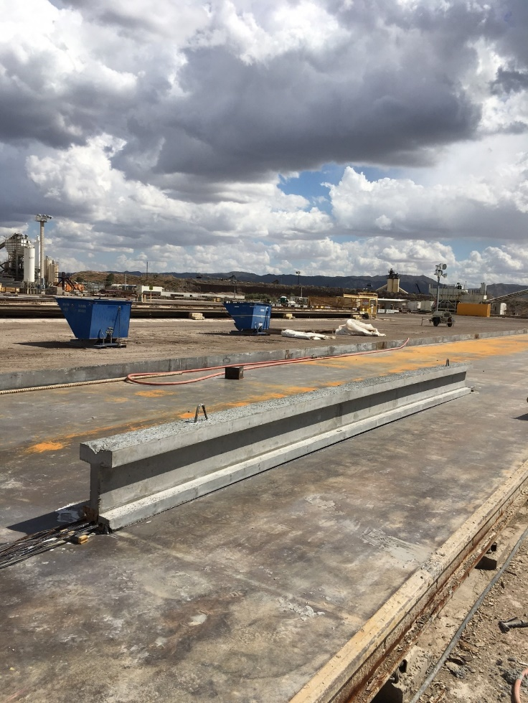
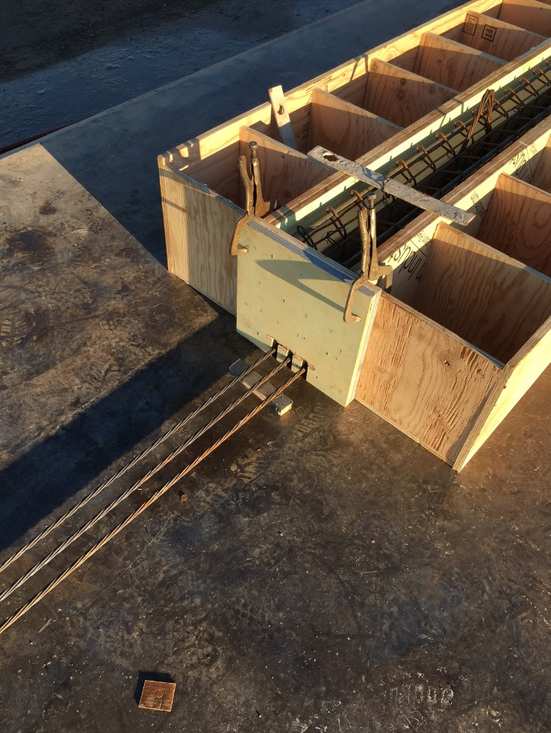
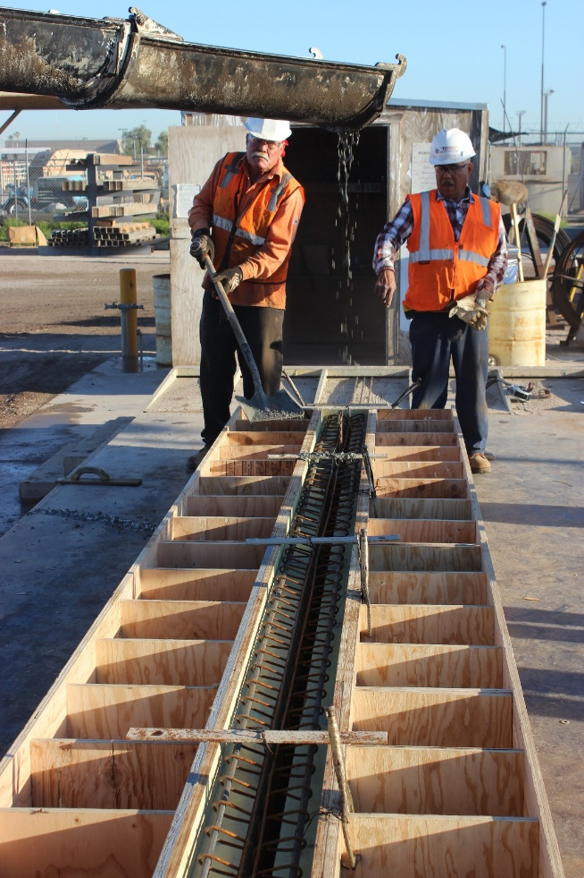
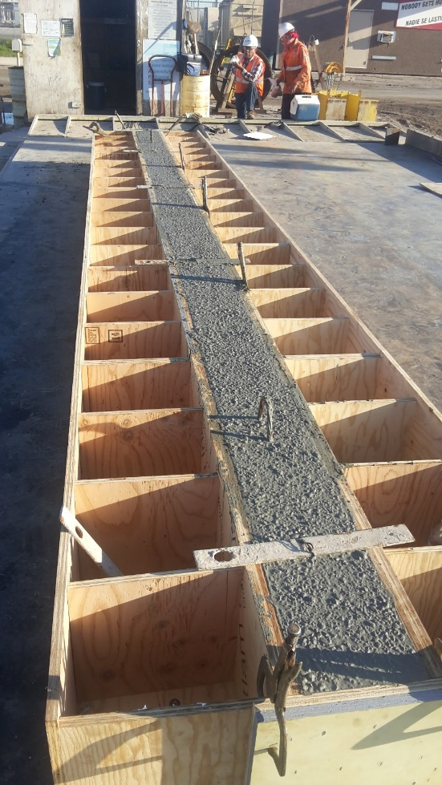
Beam Fabrication
Figure 11: Formwork [5]
Figure 12: Prestressed Strands [5]
Figure 13: Final Pour [5]
Figure 14: Two Weeks After Pour Day [2]

Slide 17
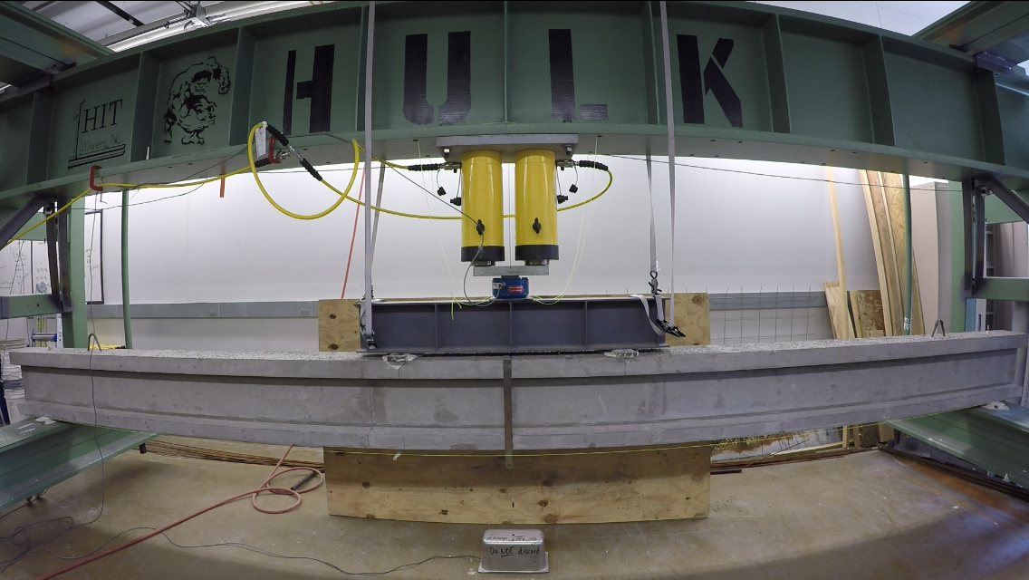
Test Setup
Piston
Loading Cell
Splitter Bar
Ruler
String Pots
Support
Support
Figure 15: Test Setup [6]

Slide 18
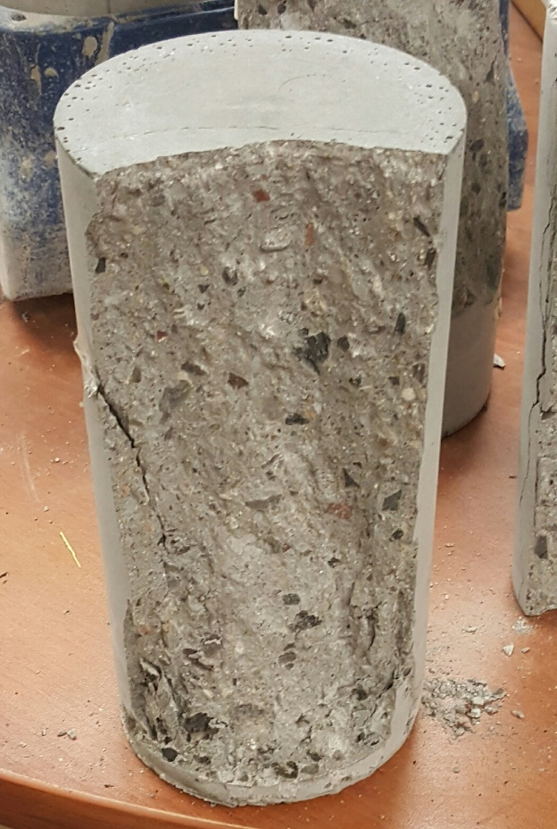
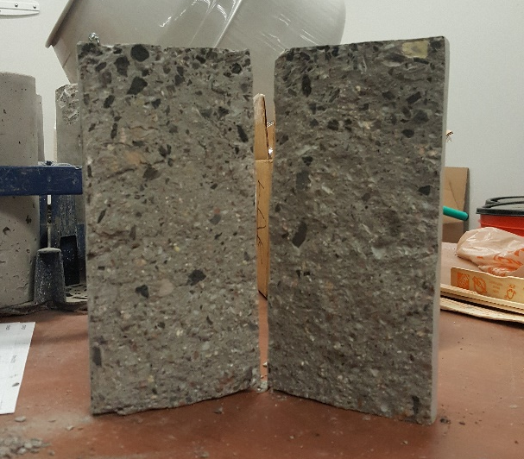
Predictions – Cylinder Testing Results
Compression – 8352 psi ± 622 psi
Tension – 405 psi ± 49 psi
Peak Strain – .00303 in/in ± .00029 in/in
Figure 16: Final Split Cylinder Test [7]
Figure 17: Final Compression Test [7]

Slide 19
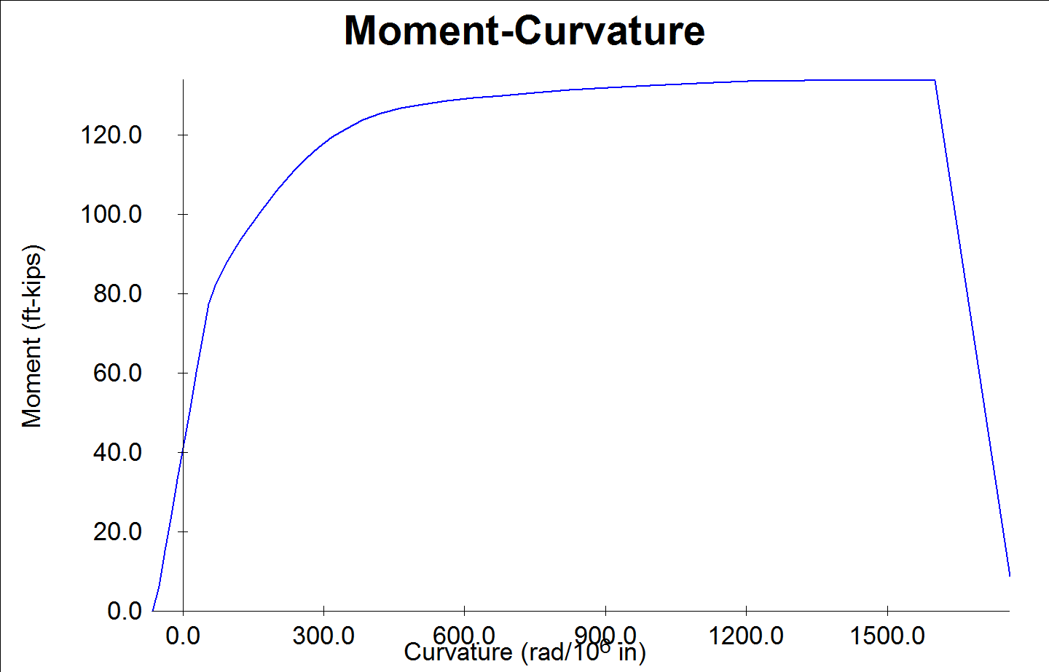

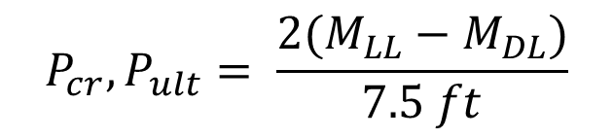
Final Predictions
Cracking Load – 20 kips
  Moment at cracking: 77.1 kip-ft
Ultimate Load – 34.80 kips
  Moment at ultimate: 134.2 kip-ft
Deflection – 3.45 inches
  Virtual work
Ultimate Moment
$$P_{cr},P_{ult}= \frac{2(M_{LL}−M_{DL})}{7.5 ft}$$
Cracking Moment
$$∆ =\int{\frac{mM}{EI}}$$
Figure 18: Response 2000 Moment-Curvature Graph [6]
Notes:
Point out cracking and ultimate moment on graph

Slide 20
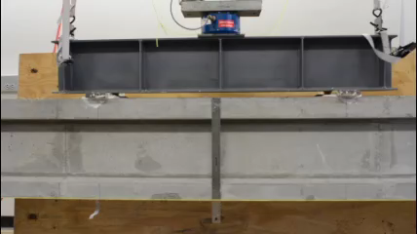
Beam Test

Slide 21
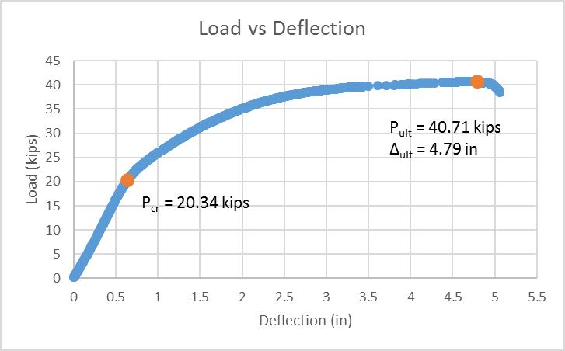
Final Results
Table 6: Final Results
 | Criteria | Predicted | Actual | %Difference
Cracking Load | 20 kips | 20 kips | 20.34 kips | 2%
Ultimate Load | 32-39 kips | 34.80 kips | 40.71 kips | 17%
Ultimate Deflection | X | 3.45 in | 4.79 in | 39%

Slide 22
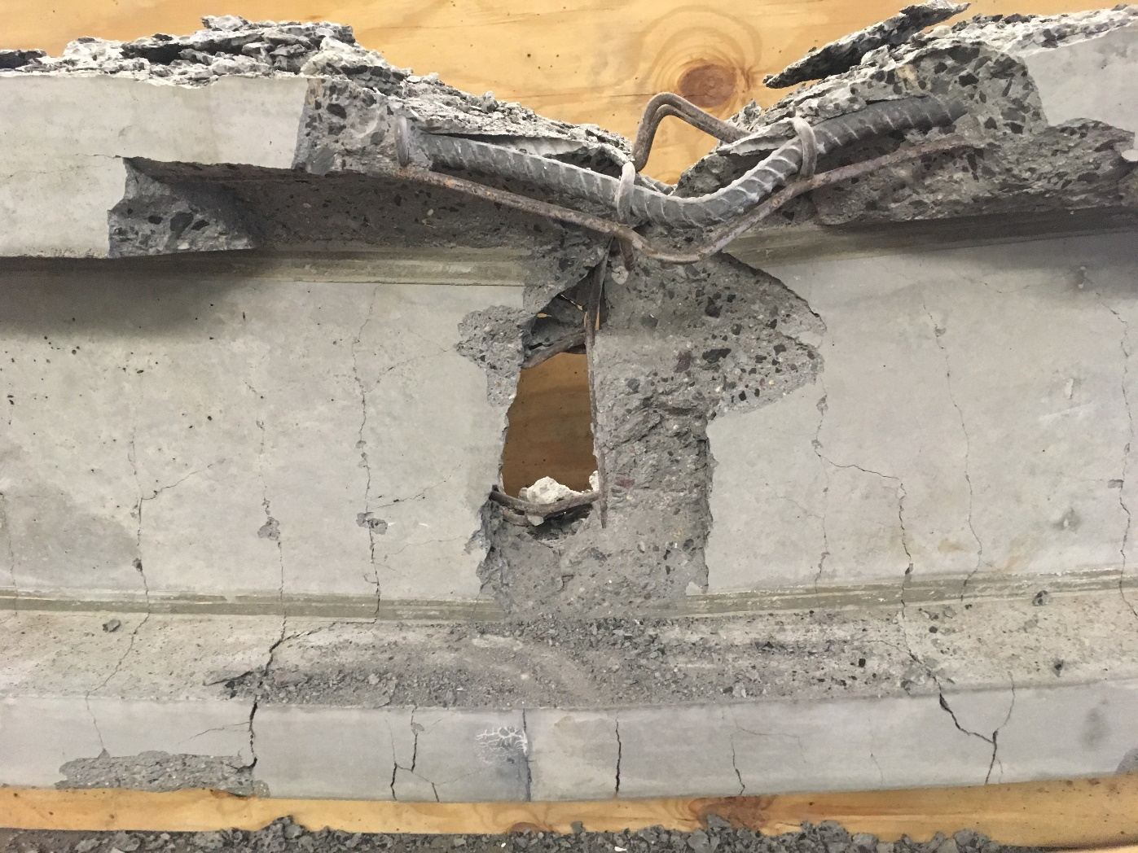
Failure
Figure 19: Beam Failure[6]

Slide 23

Project Cost
Table 7: Predicted vs Final Cost
 | Classification | Hours (hr) | Rate/ Hour ($) | Cost ($) | Hours (hr) | Rate/ Hour ($) | Cost ($)
1.0 Personnel | SENG | 138 | 140 | $19,320 | 83 | 140 | $11,620
 | ENG | 279 | 88 | $24,552 | 328 | 88 | $28,864
 | LAB | 320 | 61 | $19,520 | 320 | 61 | $19,520
 | AA | 79 | 28 | $2,212 | 160 | 28 | $4,480
 | Total |  |  | $45,039 |  |  | 64,484
2.0 Travel | Tpac meetings @ 290 miles/meeting | $0.44/mile (3 Meetings) |  | $383 | $0.44/mile (2 Meetings) |  | $255
3.0 Lab | Lab cost for equipment and facilities | 50 | 100 | $5,000 | 47 | 100 | $4,700
4.0 Subcontract | Beam fabrication |  |  | $5,000 |  |  | $5,000
5.0 Total |  |  |  | $75,987 |  |  | $74,439
 |  | Predicted |  |  | Actual

Slide 24
Project Schedule
Task Name | Scheduled Finish | Actual Finish
Task 4: Beam Fabrication | Thu 4/13/17 | Fri 4/14/17
4.1 Submit Shop Drawings | Thu 3/9/17 | Fri 2/24/17
4.2 Beam Fabrication | Mon 3/13/17 | Fri 3/17/17
4.3 Curing Time | Thu 4/13/17 | Fri 4/14/17
Task 5: Beam Testing | Fri 4/14/17 | Mon 4/17/17
5.1 Test Setup | Wed 4/12/17 | Fri 4/14/17
5.2 Final Predictions | Thu 4/13/17 | Mon 4/17/17
5.3 Beam Test | Fri 4/14/17 | Mon 4/17/17
Task 6: Beam Analysis | Tue 4/25/17 | Wed 4/19/17
Task 7: Project Management | Thu 5/11/17 | Tues 5/9/17
7.1 Communications | Fri 5/5/17
Team Meetings | Fri 5/5/17
7.1.2 Client Meetings | Fri 3/17/17 | Thu 3/16/17
7.1.2.1 TPAC Tour | Fri 9/2/16
7.1.2.2 Beam Fabrication Day | Fri 3/17/17 | Thu 3/16/17
7.2 Deliverables | Thu 5/11/17
7.2.1 50% Design Report | Tues 3/14/17 | Thurs 3/2/17
7.2.2 Final Draft of report | Mon 5/1/17
7.2.3 Website | Mon 4/24/17 | Tues 5/2/17
7.2.4 Final Presentation | Fri 5/5/17 | Fri 4/28/17
7.2.5 Final Report | Thu 5/11/17 | Tues 5/9/17
Schedule changes due to:
  Stress-Strain cylinder tests
  TPAC schedule
  Concrete mix
Table 8: Project Schedule
Task Name | Scheduled Finish | Actual Finish
Task 1: Mix Design | Sun 1/22/17 | Mon 1/30/17
1.1 Design Mix Experimental | Thu 10/20/16
1.2 Mix Design | Thu 11/3/16
1.3 Collect Materials | Fri 12/9/16
1.4 Cylinder Creation | Sun 12/11/16 | Sat 12/9/16
1.5 Curing Time | Tue 1/17/17
1.6 Cylinder Testing | Sun 1/22/17 | Mon 1/30/17
Task 2: Beam Cross-Section Design | Fri 12/9/16 | Wed 1/15/17
2.1 Creating a MathCAD model | Fri 11/25/16
2.2 Cross-Section Designs | Fri 12/9/16 | Wed 2/24/17
Task 3: Final Design | Tue 2/28/17 | Fri 2/24/17

Slide 25
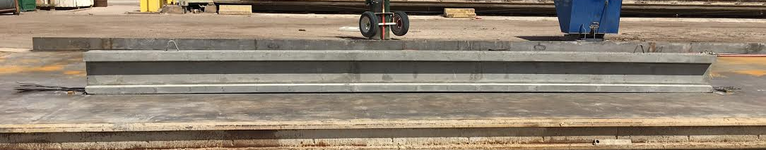
Acknowledgements
Vince Rossi, PE | Design Engineer - TPAC
Dr. Robin Tuchscherer
Northern Arizona University

Slide 26
References
[1] Photo by Rick Wilson
[2] Photo by Vince Rossi
[3] PCI Logo. "PCI | Student Education", Pci.org, 2017. [Online]. Available: http://www.pci.org/education/student_education/.
[4] PCI Big Beam Rules 2017. [Online]. Available: http://www.pci.org/uploadedFiles/Siteroot/Education/_Related_Content/EDU16-3271_Big%20Beam%20Brochure_Web.pdf.
[5] Photo by Mohammed Alradhi
[6] Photo by Kacy Aoki
[7] Photo by Qusai Al Ghalbi

Slide 27
